Slide 1
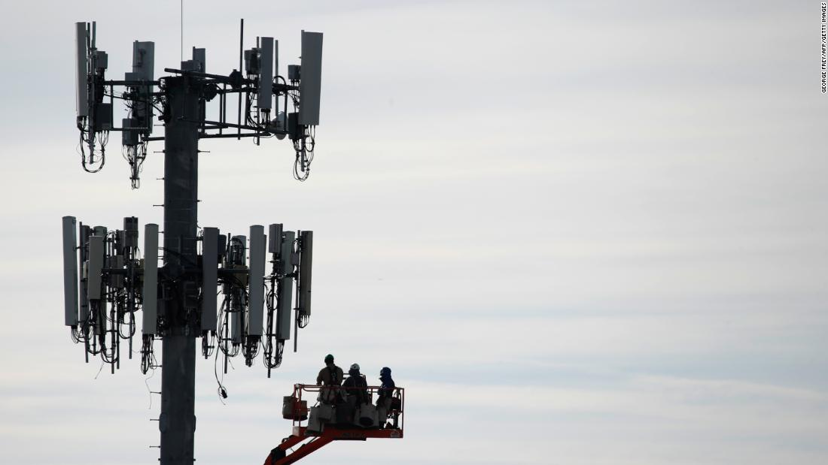
5G Networks and Coronavirus
Bryce Jones
Eli Lobato
Yannick Befidi

Slide 2
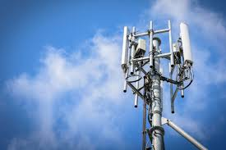
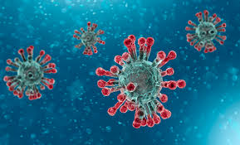
Hypothesis
The purpose of this study is to find out how the 5G towers are effecting the current populace when it pertains to the Coronavirus outbreak.

Slide 3
Background Information
Electromagnetic radiation has been classified by the International Agency for Research on Cancer (IARC) as "Possibly carcinogenic to humans".(1)
“Another complicating factor is that at least 25% of the people who are transmitting the virus may be asymptomatic at the time… That suggests coughs and sneezes aren't necessary to transmit the virus, though it's not clear whether simply breathing spreads the virus, or whether talking is required.”(2)
“The expansion of the 5G network, intended to enable faster wireless transmission of larger amounts of data, requires the installation of many more antennas in urban areas. In this way, the scientists argue, there is no longer anyone escaping the potentially harmful effects of radiation. After all, we are already exposed to 2G, 3G, 4G and Wi-Fi radiation.(3)

Slide 4
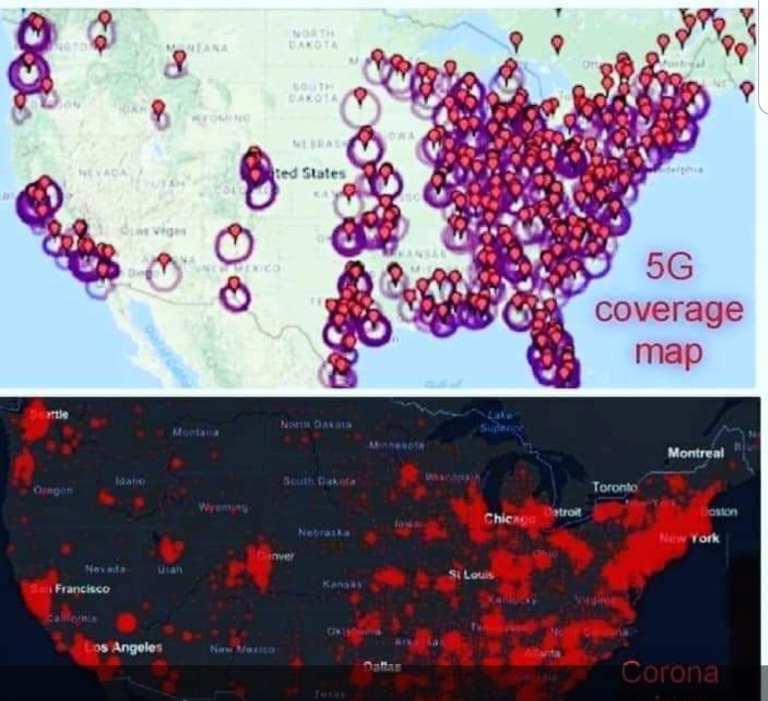
Comparison Map

Slide 5
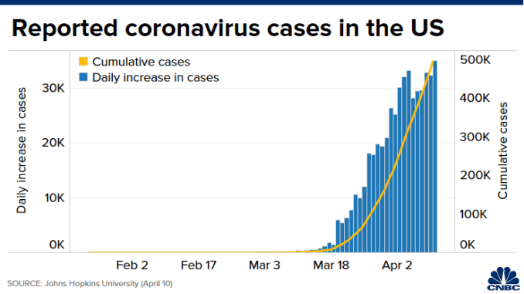
Coronavirus cases in US

Slide 6
Sources:
1. "IARC Classifies Radiofrequency Electromagnetic Fields as Possibly Carcinogenic to Humans" (PDF). www.iarc.fr (Press Release). WHO. 31 May 2011.
2. “How are people getting infected with COVID-19" . https://www.livescience.com/how-covid-19-spreads-transmission-routes.html. 7 April 2019.
3. "EU 5G Appeal – Scientists warn of potential serious health effects of 5G" . 31 May 2019.

